Slide 1
Building Together
User Testing

Slide 2
Outdated PDFs
B2C=Pro Se

Slide 3
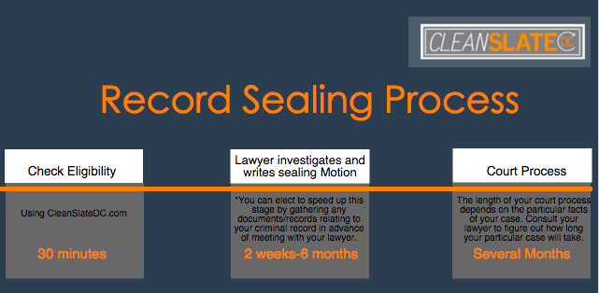
Up-to-date Pathways

Slide 4
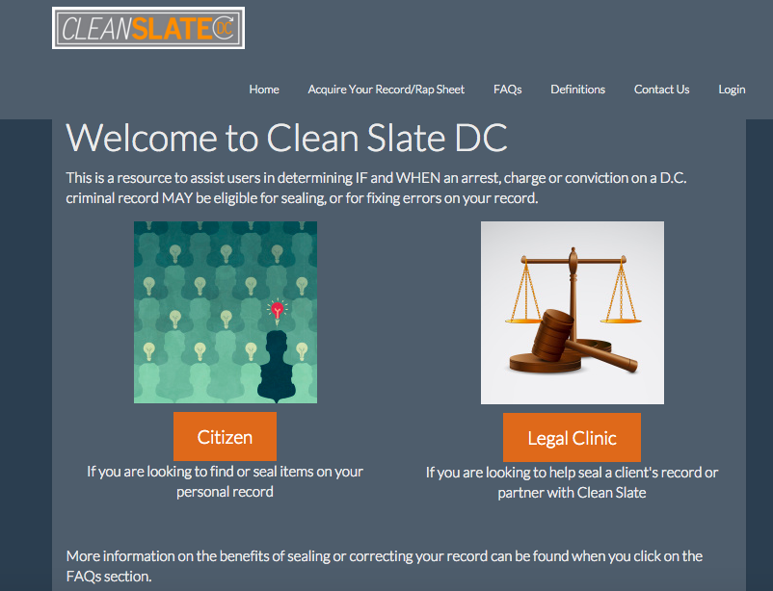
B2B vs. B2C

Slide 5
B2B=Safety Net of Legal Aid

Slide 6
